Slide 1
Unit 1
I am
He/ she is
you/ we/they are

Slide 2
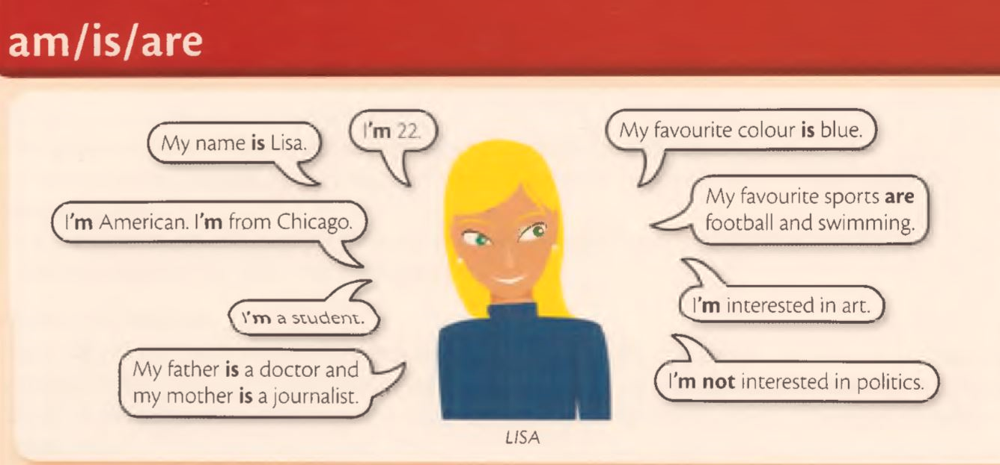

Slide 3
I’m cold, can you close the window please?

Slide 4
I’m 32 years old, my sister is 29.

Slide 5
Steve is ill, he is in bed.

Slide 6
My brother is scared of dogs.

Slide 7
It’s ten o’clock. You’re late again.

Slide 8
Ann and I are good friends.

Slide 9
Your keys are on the table.

Slide 10
I’m tired but I’m not hungry.

Slide 11
Lisa isn’t interested in the politics. She is interested in art.

Slide 12
James isn’t a teacher. He is a student.

Slide 13
Those people aren’t English. They’re Australian.

Slide 14
It’s sunny today, but it isn’t warm.

Slide 15
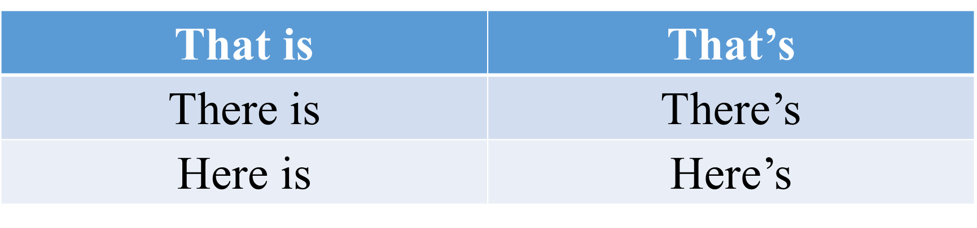

Slide 16
Thank you, that’s very kind of you.

Slide 17
Look, there’s Chris.

Slide 18
Here’s your key. Thank you.

Slide 19
Write the short form
She is
They are
It is not
That is
I am not
You are not

Slide 20
Write am, is or are
The weather ….nice today.
I….not rich.
This bag ….heavy.
These bags …..heavy.

Slide 21
Look! There …. Carol.
My brother and I …. good tennis players.
Emily …. at home. Her children ….at school.
I…. a taxi driver. My sister….a nurse.

Slide 22
Complete the sentences
Stave is ill. …. in bed.
I'm not hungry, but …. thirsty.
Mr. Thomas …. a very old man. …. 98.
These chairs aren't beautiful, but …. comfortable.

Slide 23
The weather is nice today. …..warm and sunny.
“….. late." "No, ….. . I'm early!"
Catherine isn't at home. ….. at work.
“….. your coat." "Oh, thank you very much."

Slide 24
Look at Lisa's sentences in 1A; write sentences about yourself

Slide 25
My name is ….
I'm from ….
I'm …..
I'm …..
My favorite color is …..
I'm interested in …..

Slide 26
Write sentences for the pictures. Use:
Angry
Cold
Hot
Hungry
Scared
thirsty

Slide 27
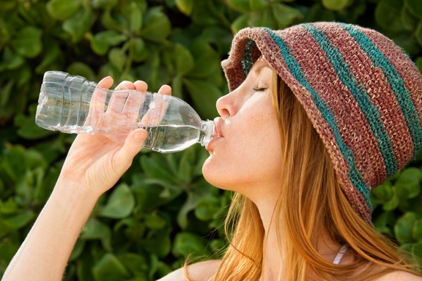
She's thirsty.

Slide 28
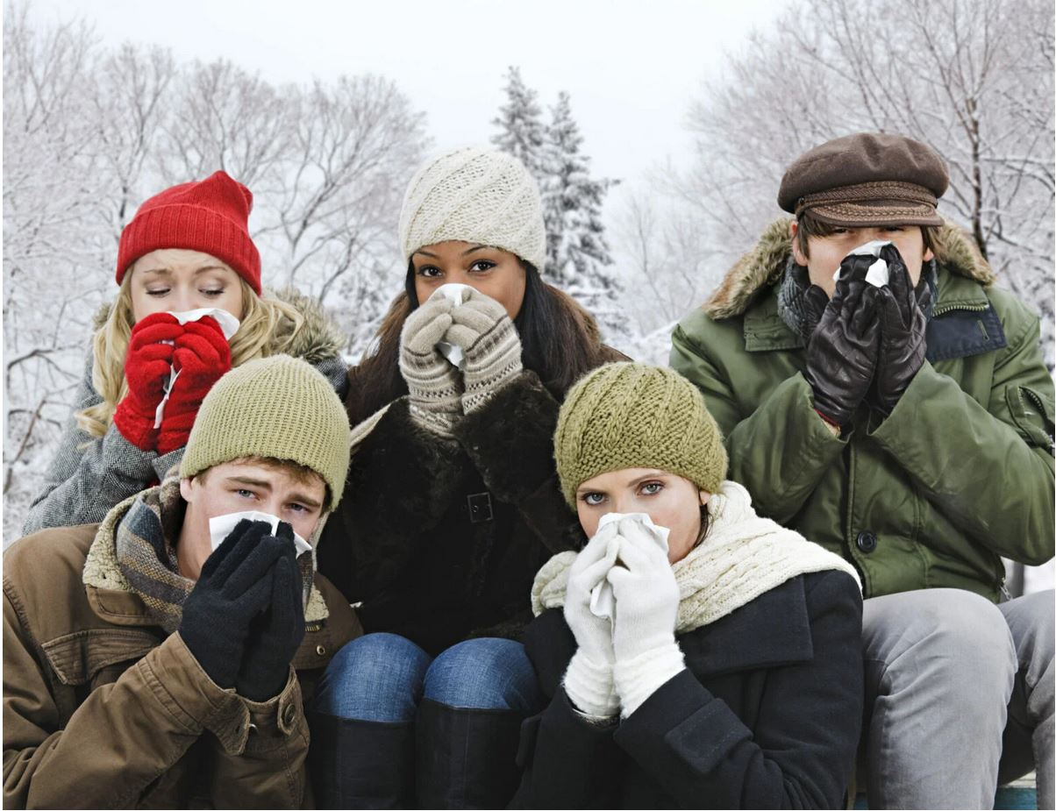
They're cold.

Slide 29
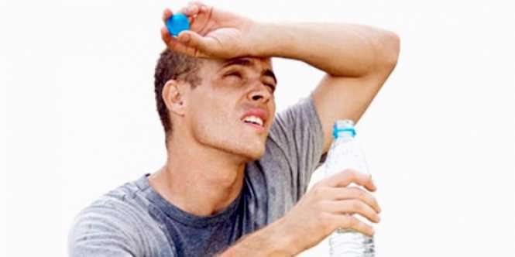
He's hot.

Slide 30
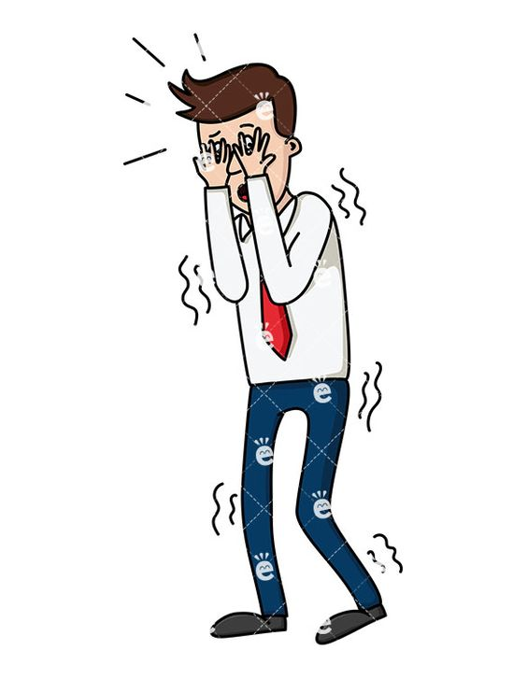
He's scared.

Slide 31
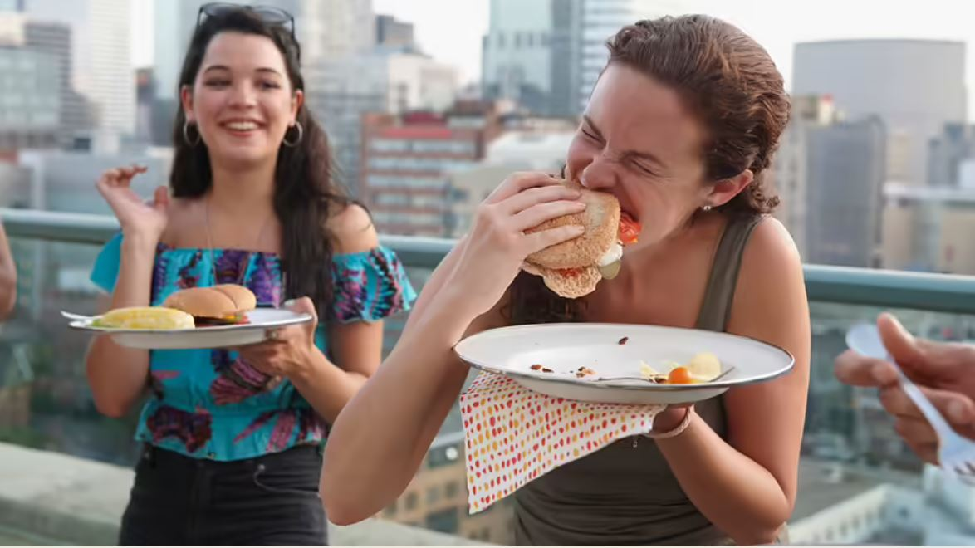
They're hungry.

Slide 32
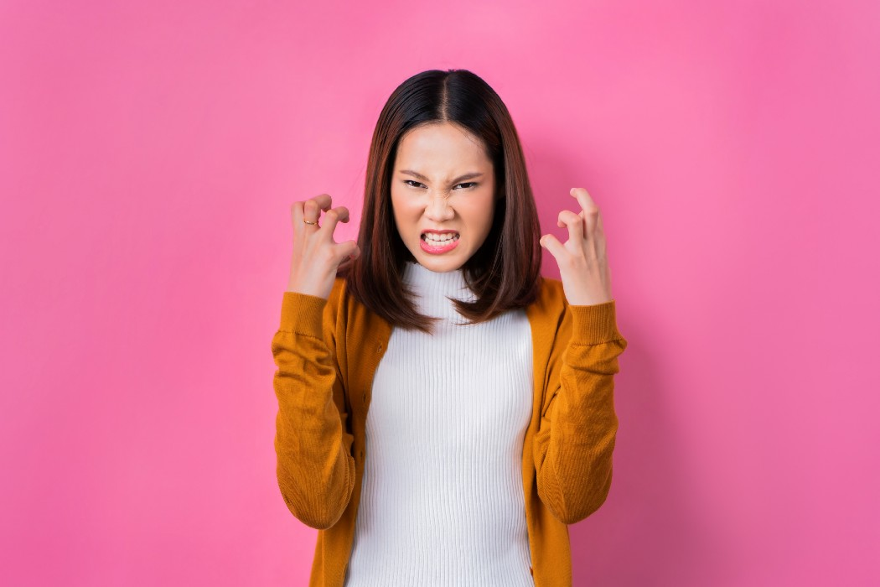
She's angry.

Slide 33
Write true sentences, positive or negative. Use is/isn't or are/aren't

Slide 34
it/ hot today
it/ windy today
My hands/ cold
Brazil/a very big country
Diamonds/ cheap.
Toronto/in the US.

Slide 35
Write true sentences. positive or negative. Use I'm/I'm not

Slide 36
Write true sentences. positive or negative. Use I'm/I'm not
tired.
hungry.
good swimmer.
interested in football.

